Slide 1

Note: The data and information in this document is reflective of a hypothetical situation and client. This document is to be used for KPMG Virtual Internship purposes only.

Slide 2

Note: The data and information in this document is reflective of a hypothetical situation and client. This document is to be used for KPMG Virtual Internship purposes only.
1. Introduction
2. Data Exploration
3. Model Development
4. Interpretation

Slide 3

Note: The data and information in this document is reflective of a hypothetical situation and client. This document is to be used for KPMG Virtual Internship purposes only.
Identify & Recommending High Values Customers
Outline Of Problem
Approach For Data Analysis
• Bike Related Purchase for the last 3 years
based on gender
• Sprocket Central is a company that specializes in
high quality bike and accessories
• Top Industries contributing the maximum profit
and bike related sales
• The Marketing team is looking to boost sales
• To target 1000 new customer that will bring the
highest value to the business
• Wealth segment by age category
• Number of car owned in each state
• Customer Clarification

Slide 4

Note: The data and information in this document is reflective of a hypothetical situation and client. This document is to be used for KPMG Virtual Internship purposes only.
Data Quality Assessment
Key issue dealt with for the data quality issue
Accuracy
Completeness
Consistency
Currency
Relevancy
Validity
Customer
Demographic
DOB: Inaccurate
Age: Missing
Tenure: Blanks
Job Title: Blanks
Job Industry: n/a
Customer ID:
Incomplete
Gender:
Inconsistent
Deceased
Customer:
Filtered Out
Default Column:
Delete
Customer
Address
Customer ID:
Incomplete
States:
Inconsistent
Transactions
Profit: Missing
Customer ID:
Incomplete
Online Orders: Blanks
Brands: Blanks
Cancelled Status
Order: Filtered
Out
List Price:
Format
Product Sold
Date: Format

Slide 5

Note: The data and information in this document is reflective of a hypothetical situation and client. This document is to be used for KPMG Virtual Internship purposes only.
Bike Related Purchase Over Last 3 Years Based On Gender
Difference of Gender on Bike related
purchase
• Data Shows, on average female have made
more bike related purchase in the last 3
years compared to males.
100%
90%
80%
70%
60%
50%
40%
30%
20%
10%
0%
• On Average Females had 2% higher bike
related purchase compared to men in last 3
years.
Total
51.31%
48.69%
Female
Male

Slide 6
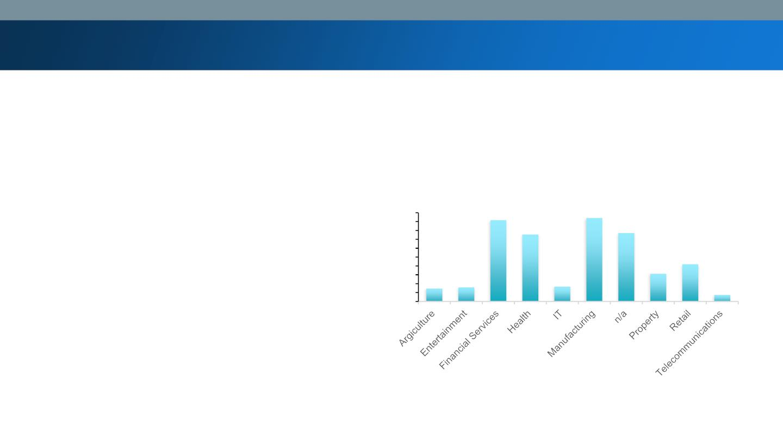
Note: The data and information in this document is reflective of a hypothetical situation and client. This document is to be used for KPMG Virtual Internship purposes only.
Top Job Industry Contributing to the maxing Profit & Bike Related
Purchases
Bike related purchase based on
industry
•
•
Top 3 industry sector bringing in the highest profits are
Financial services, Manufacturing & Health.
$ 200,000
$ 180,000
$ 160,000
$ 140,000
$ 120,000
$ 100,000
$ 80,000
$ 60,000
$ 40,000
$ 20,000
$ -
These can be obvious as most of the industry sectors are
based within the city or on the outskirts of the city
therefore consumers prefer bikes for commuting
•
Most of the Industry sectors have returned less than
$1,000,000 in profits

Slide 7
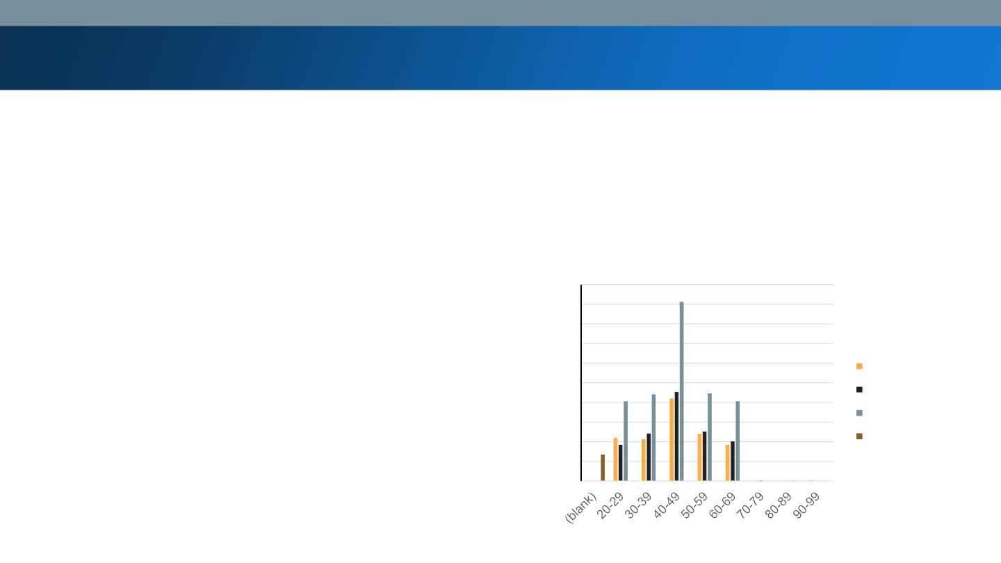
Note: The data and information in this document is reflective of a hypothetical situation and client. This document is to be used for KPMG Virtual Internship purposes only.
Profit of wealth segment by age cluster
• Over all the mass customer segmentation make the
Age Clusters Profit
highest profit across the different age clusters
$ 2,000,000.00
$ 1,800,000.00
$ 1,600,000.00
$ 1,400,000.00
$ 1,200,000.00
$ 1,000,000.00
$ 800,000.00
$ 600,000.00
$ 400,000.00
$ 200,000.00
$ -
• Mass Customer aged between 40-49 are likely to
bring more profits for the company compare to
other age clusters
Affluent Customer
High Net Worth
Mass Customer
(blank)
• This also indicates a trend of buying power as the
buying power increases over time till 47 and then
see’s a decline in buying power, thus lead to lower
profits

Slide 8
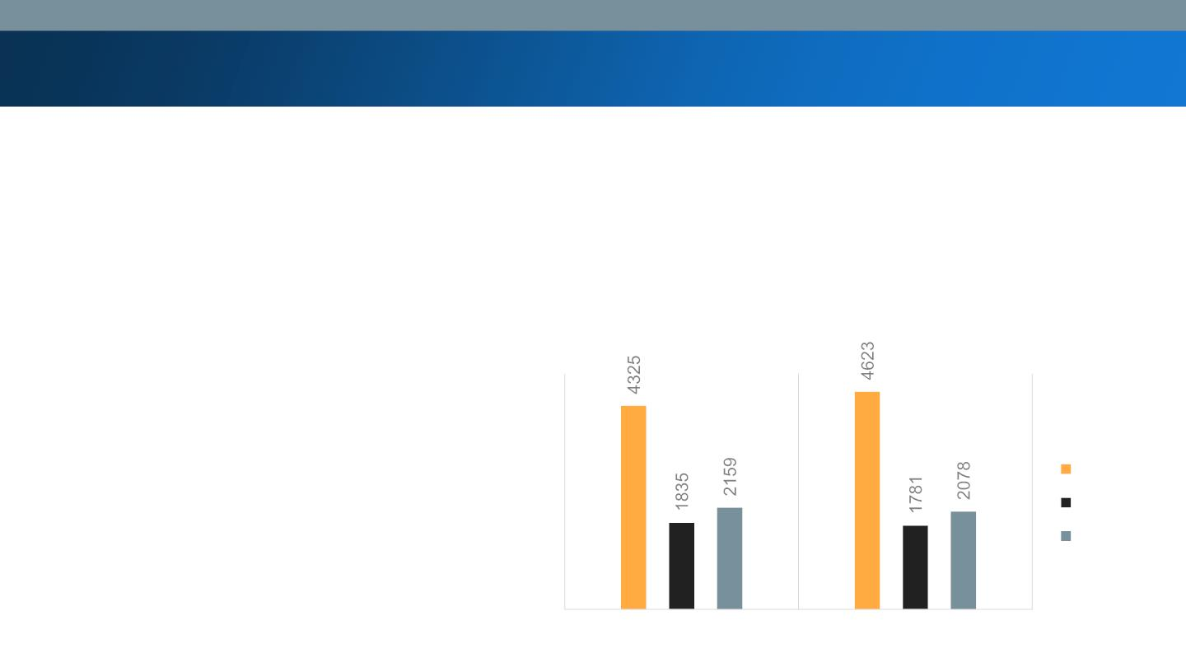
Note: The data and information in this document is reflective of a hypothetical situation and client. This document is to be used for KPMG Virtual Internship purposes only.
Number of car owns in each state
NUMBER OF CAR IN
EACH STATE
• NSW has the highest potential as the number of
people own car is almost equal to the people
who don’t own cars which shows that there is
opportunity to find value customer there.
NSW
QLD
VIC
No
Yes

Slide 9
Note: The data and information in this document is reflective of a hypothetical situation and client. This document is to be used for KPMG Virtual Internship purposes only.
Customer Classification – Targeting High Value Customers
• These are the high values customer you should be targeted from the new list:
i.
High Value Customers are Female compare to male
ii. Working in the financial services, Health and Manufacturing Indutry Sector.
iii. Age between 40-49 should be targeted
iv. NSW should be in main refrence as the no. of population are more as compared to other state

Slide 10
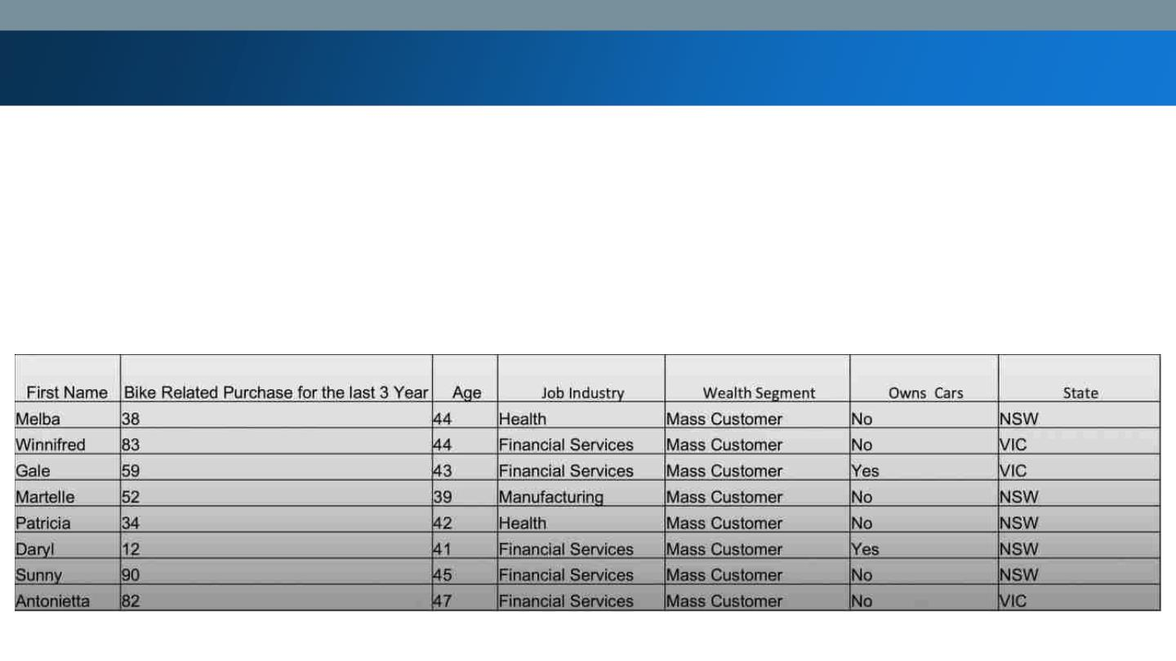
Note: The data and information in this document is reflective of a hypothetical situation and client. This document is to be used for KPMG Virtual Internship purposes only.
Summary Table for high value customers
• Here is a snapshot of a few customer that will come under the high value customer classification

Slide 11

Note: The data and information in this document is reflective of a hypothetical situation and client. This document is to be used for KPMG Virtual Internship purposes only.

